Slide 1

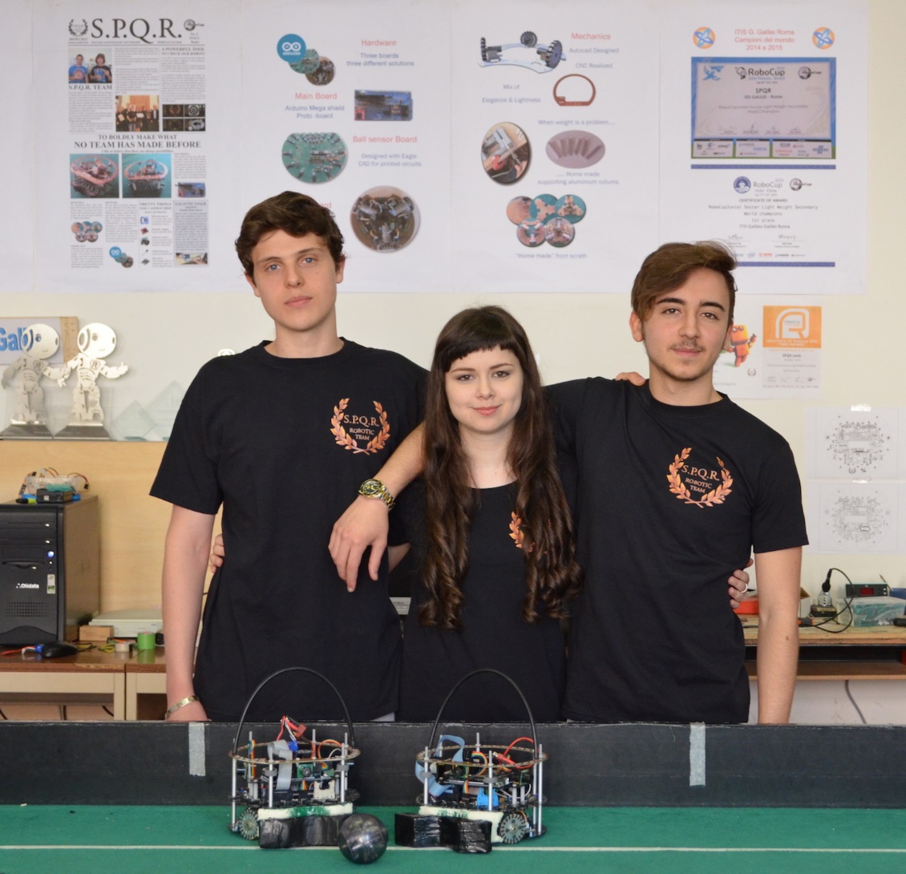

ITIS Galileo Galilei Rome
S.P.Q.R. Team

Slide 2
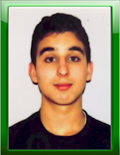
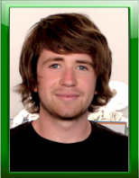
S.P.Q.R. Team
Name: Enrico Di Claudio
Age: 17
Role: Hardware
Note: cyclist, electronics, sport
Name: Giulia De Iulis
Age: 18
Role: Electronics
Note: fond of astronomy, reading, piano
Year 2016 representatives
Name: Flavio Galasso
Age: 17
Role: Software
Note: hacker, music composer, gymnast

Slide 3


S.P.Q.R. Background
We are students of “Automation”
We are part of the team since 2014.
SPQR Robocup Junior Soccer Light weight Placements
2012: 1° place RomeCup, 1° place AustrianOpen 3° place super Team Mexico
2013: 1° place RomeCup, 1° place AustrianOpen, Best Teamwork Heindoven
2014: 1° place RomeCup, 1° place AustrianOpen, World Champions Brasil
2015: 1° place RomeCup, 2° place AustrianOpen, world champions Hefei (China)
2016: 1° place RomeCup, 2° place AustrianOpen

Slide 4

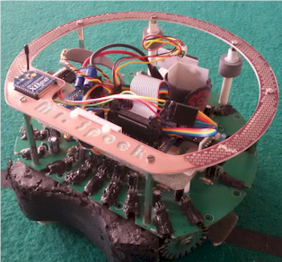
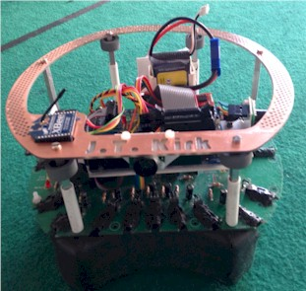
Robot generation 2015
Name: Mr. Spock
Age: 1 year
Role: goal keeper
Name: J. T. Kirk
Age: 1 year
Role: goalie

Slide 5
Completely redesigned 2016 new generation
Name: Salvador
Age: just born
Role: goal keeper
Electronics: New boards, IMU, line sensors
Mechanics: New CAD design, handle and columns
Software: New strategy

Slide 6
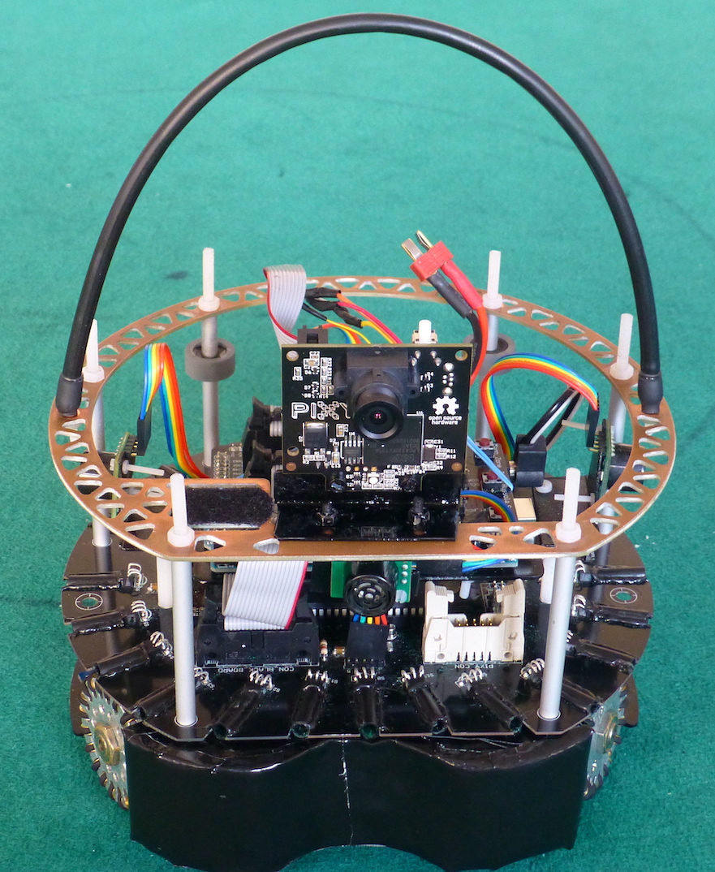
Completely redesigned 2016 new generation
Name: Manfreus
Age: just born
Role: goalie
Electronics: New boards, IMU, line sensors, Pixy
Mechanics: New CAD design, handle and columns
Software: New strategy

Slide 7
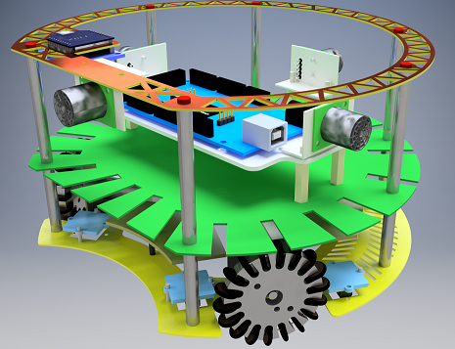
Hardware
Realized with our CNC
Lightness &
Solidity
compromise
Three boards designed with Autocad & Eagle

Slide 8

Main Board
New Arduino Mega Shield
MEGA
Links all boards to Arduino Mega
Command buttons easily reachable and well placed
Different sockets for different compasses
Extra pins for expansion
Signalising leds

Slide 9
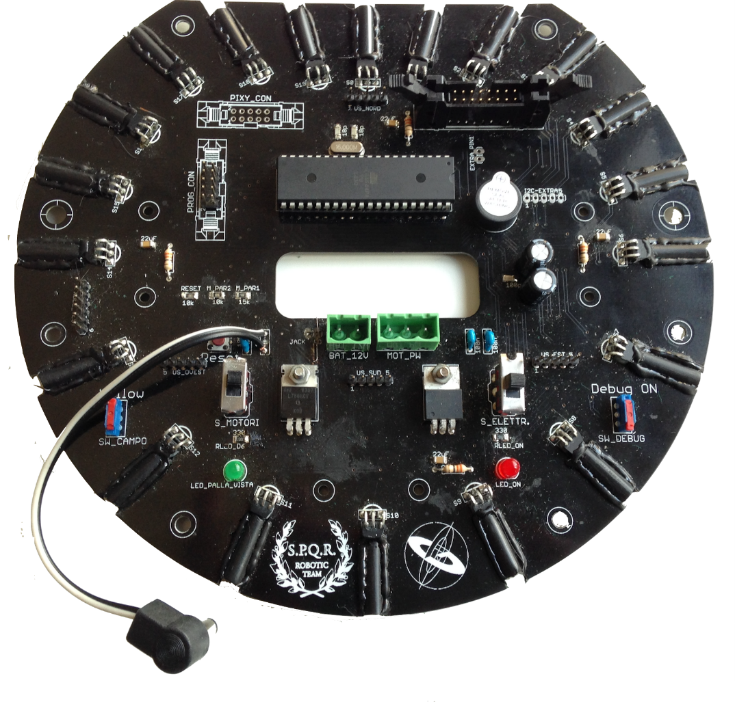
Ball sensors Board
20 sensors for better ball identification
Command switches set apart to avoid mistakes
Slave ATMega 644p SPI Connected to Arduino Mega
PIXY Connection

Slide 10
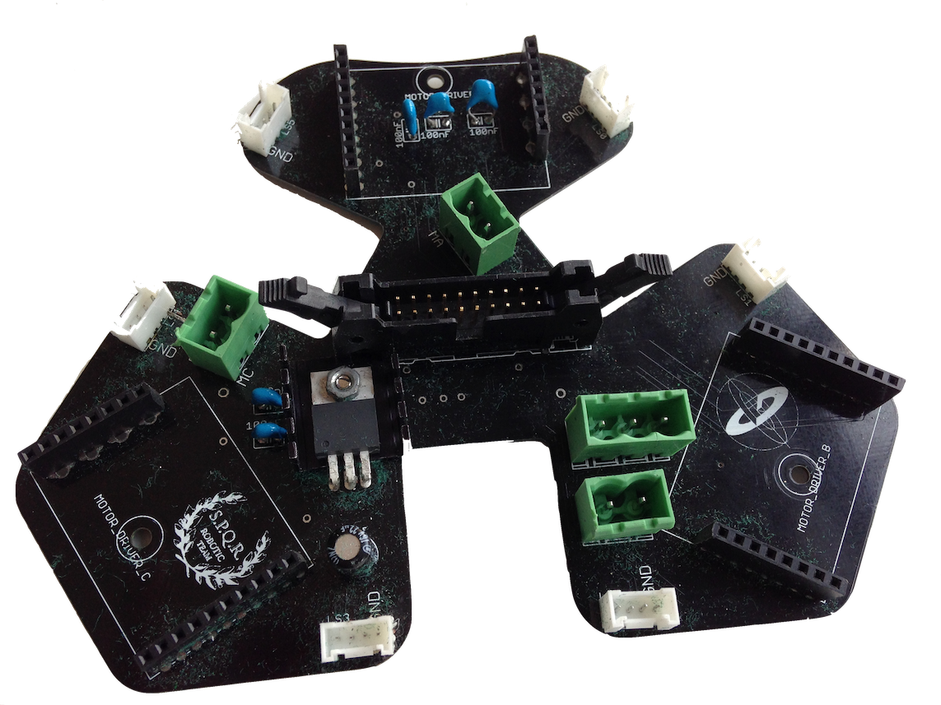
Motor Board
6 Line sensors PCINT connected
New line detection strategy
3 Pololu VNH5019A

Slide 11
PIXY vision to detect the opponent goal

Slide 12
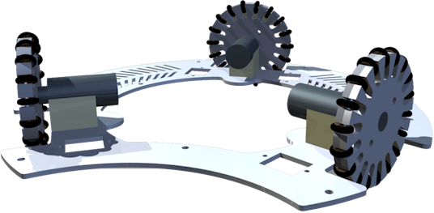
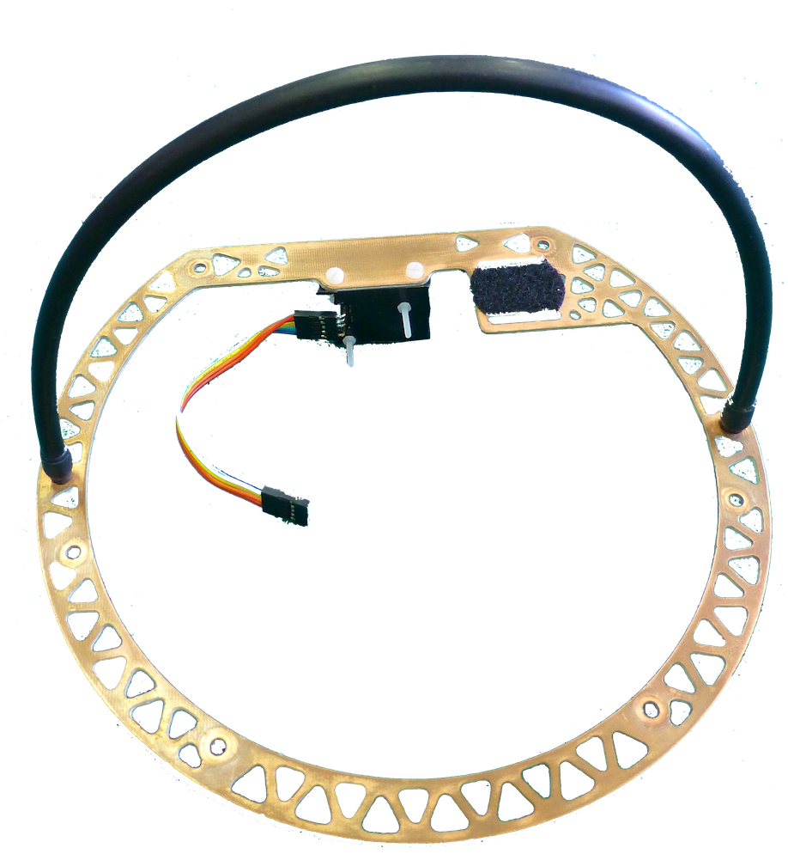
Mechanics
Designed with Autocad
CNC Realized
Elegance and lightness mix

Slide 13
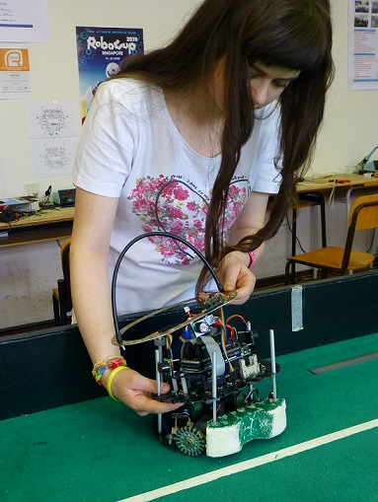
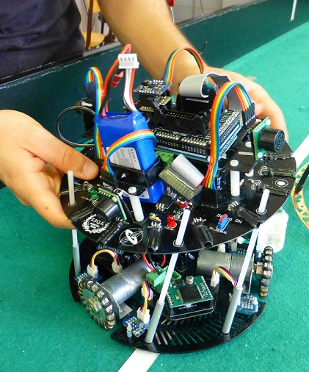
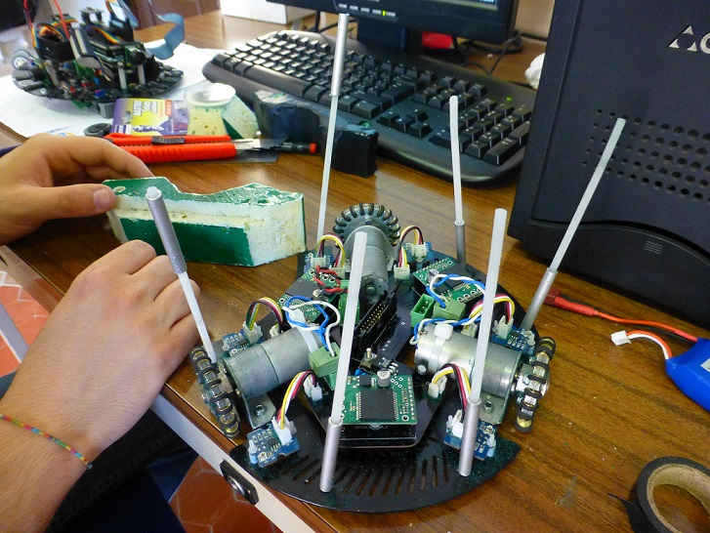
Easy access to all boards
1. Take out the handle
2. Take out the ball board
3. Motor board ready
Nylon screws inside home made aluminium columns

Slide 14

Software
The main board program is in Arduino C
The ball sensor board program is in Arduino C
The Debug Station program is in Processing
The two robots software aren’t the same:
The goalie tries to attack and score if it “sees” the ball
The goal keeper moves forward only when the ball is near
Different software prevents robots from hinder each other

Slide 15
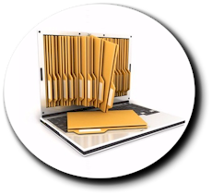
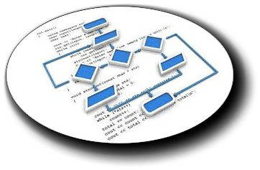

SW documentation
Flow Chart
Comments

Slide 16

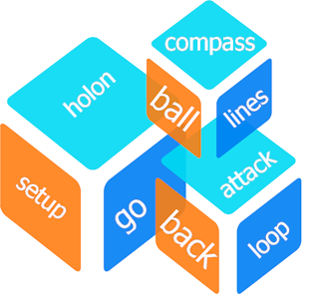
SW making
Modularity is the key for a good software

Slide 17

Debug Station
It allows us to check robot
hardware and software

Slide 18
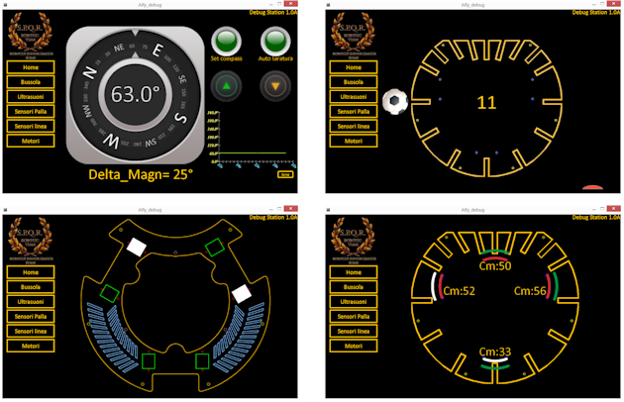
Checking the sensors
A “Processing” test bed for our robots

